Slide 1
EE 441 Data Structures
Lecture 3:
Algorithm Complexity

Slide 2
Algorithm
An algorithm :
A computable set of steps to achieve a desired result.
precisely specified using an appropriate mathematical formalism--such as a programming language.
Efficiency of an algorithm:
Less consumption of computing resources (execution time (CPU cycles), memory)
We will focus on time efficiency

Slide 3
Measuring Efficiency
Two algorithms that accomplish the same task
Which one is better???
You can run the algorithm and see the efficiency!!
Benchmarking:
Run the program and measure runtime
Disadvantage:
Execution time depends on a number of different factors:
Programming language, compiler, operating system, computer architecture, input data.
No information about the fundamental nature of the program

Slide 4
Measuring Efficiency
Given an algorithm, is it possible to determine how long it will take to run?
Input is unknown
Do not want to trace all possible execution paths
For different inputs, is it possible to determine how an algorithm’s runtime changes?

Slide 5
Analysis of an Algorithm
Predicting the resources that the algorithm requires
Resources: memory, communication bandwidth, hardware but MOSTLY TIME
In general the run time of a given algorithm grows by the size of the input
Growth rate: How quickly the run time of an algorithm grows as a function of the problem input size
Input size (N): number of items to be sorted, number of bits to represent the quantities etc.

Slide 6
Types of Analysis
Worst case
Largest possible running time of algorithm on input of a given size.
Provides an upper bound on running time
An absolute guarantee that the algorithm would not run longer, no matter what the inputs are
Best case
Provides a lower bound on running time
Input is the one for which the algorithm runs the fastest

Slide 7
Types of Analysis
Average Case:
Obtain bound on running time of algorithm on random input as a function of input size.
Hard (or impossible) to accurately model real instances by random distributions.
Algorithm tuned for a certain distribution may perform poorly on other inputs.

Slide 8
When does average case matter?
Example: Design an algorithm that searches for a student in METU student database with certain properties (in third year, double major in physics)
Worst case : No such student exists (rare). Algorithm searches the whole database and cannot find a match!
Algorithm 1:
Average run time=1 sec
Worst case run time=8 sec
Algorithm 2:
Average run time=4 sec
Worst case run time=5 sec
WHICH ALGORITHM WILL YOU CHOOSE??

Slide 9
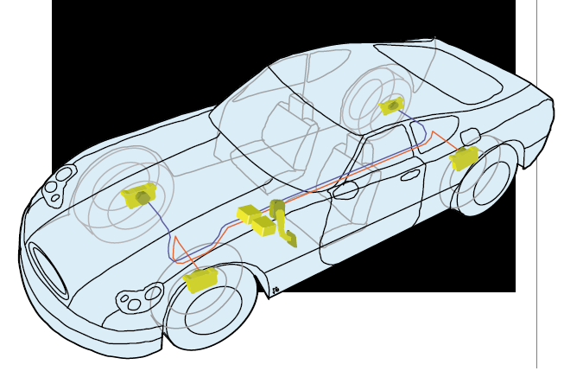
When does worst case matter?
Example: Algorithm that computes the brake force in a brake by wire vehicle:
Brake is performed by a motor located at the wheels controlled by a computer
You are driving the car
You see the obstacle
The road is wet
You press on the brake

Slide 10
When does worst case matter?
An algorithm in the vehicle computer computes the actual braking force according to your braking force and road conditions.
Sends the brake force value to the motor at the wheels
What is the design constraint of the algorithm???

Slide 11
When does worst case matter?
Suppose: The algorithm has to generate a result in a maximum of 2msec such that you do not crash the object.
The worst case run time should not exceed 2 msec
You do not care about the average case!
Real time system that is life critical!

Slide 12
Measuring Efficiency
Analysis:
Examine the program code
Assume each execution of statement i takes time t_{i} (constant)
Find how many times each statement is executed for a given input
Find worst cases
Some algorithms perform well for most cases but are very inefficient for few inputs: Average cases are important too!

Slide 13
Example
int sum (int n)
{
int result=0; ➔t1
for(int i=1;i<=n; i++) ➔t2a t2b t2c
result+=i; ➔t3
return result; ➔t4
}
Time it takes to run:
T(n)=t1+t2a+(n+1)t2b+nt2c+nt3+t4
Checks including the last step where i>n for the first time

Slide 14
Some conclusions
Running time T(n) depends on the problem size n.
Usually T(n) is fixed for a certain n
Question: What if the algorithm does some operations based on the outcome of a random variable?

Slide 15
Some conclusions
We ignored the actual cost of each statement.
We used t1 for time but we don’t know how many nsec it takes to execute int result=0 on Intel core i7 processor.
We can simplify further➔ Just look at the TREND in time vs problem size rather than exact time

Slide 16
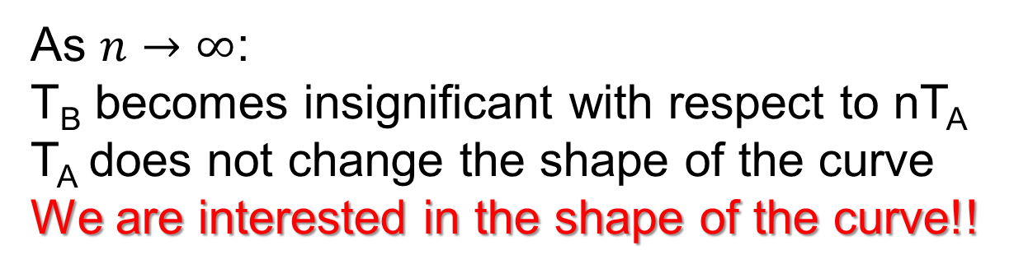
Rate of Growth
Remember:
T(n)=t1+t2a+(n+1)t2b+nt2c+nt3+t4
T(n)= n(t2b+t2c+t3)+t1+t2a+t2b+t4
T(n)=T_{A}n+T_{B}
T(n)
n
As $n→∞$:
T_{B} becomes insignificant with respect to nT_{A}
T_{A} does not change the shape of the curve
We are interested in the shape of the curve!!

Slide 17
Algorithm to solve a problem
Problem:
An ordered array of N items
Find a desired item in the array
If the item exists in the array, return the index
Return -1 if no match is found
There can be more than one solution➔
Different algorithms

Slide 18
Algorithm 1: Sequential Search
int SeqSearch(DataType list[ ], int n, DataType key)
{ // note DataType must be defined earlier
// e.g., typedef int DataType;
// or typedef float DataType; etc.
for (int i=0; i<n; i++)
if (list[i]==key)
return i;
return –1;
}
Idea:
Check all elements in the array one by one
from the beginning until:
The desired item is found ➔ Success
End of the array➔ no success
worst case:
n comparisons (operations) performed
expected (average):
n/2 comparisons
expected computation time α n

Slide 19
Algorithm 1: Sequential Search
expected computation time α n
e.g., if the algorithm takes 1 ms with 100 elements
it takes ~5 ms with 500 elements ~200ms with 20000 elements etc.

Slide 20
Algorithm 2: Binary Search
list[5]
Idea:
Use a sorted array
Compare the element at the middle with the searched item
Decide which half of the array can contain the searched item
5 17 36 37 45
0 1 2 3 4
low (initially)
high (initially)
Search for 37
Middle is 36
If 37 exists it has to be in the higher part of the array
5 17 36 37 45
0 1 2 3 4
low (next)
high (next)

Slide 21
Algorithm 2: Binary Search
int BinarySearch(DataType list[], int low, int high, DataType key)
{
int mid;
DataType midvalue;
while (low<=high)
{
mid=(low+high)/2; // note integer division, middle of array
midvalue=list[mid];
if (key==midvalue) return mid;
else if (key<midvalue) high=mid-1;
else low=mid+1;
}
return –1;
}
list[]
0 1 2 3 . . . . N
low (initially)
high (initially)

Slide 22
Binary Search
e.g. int list[5]={5,17,36,37,45};
low=0, high=4 key=44
list[5]
5 17 36 37 45
0 1 2 3 4
low (initially)
high (initially)
1) mid=(0+4)/2=2
midvalue=list[2]=36
key>midvalue
low=mid+1=3
list[5]
5 17 36 37 45
0 1 2 3 4
low (after step1)
high (unchanged)

Slide 23
Binary Search
e.g. int list[5]={5,17,36,37,45};
low=0, high=4 key=44
list[5]
5 17 36 37 45
0 1 2 3 4
2) mid=(3+4)/2=3
midvalue=list[3]=37
key>midvalue
low=mid+1=4
low (after step1)
high (unchanged)
list[5]
5 17 36 37 45
0 1 2 3 4
high (unchanged)
low (after step2)

Slide 24
Binary Search
e.g. int list[5]={5,17,36,37,45};
low=0, high=4 key=44
list[5]
5 17 36 37 45
0 1 2 3 4
3) mid=(4+4)/2=4
midvalue=list[4]=45
key<midvalue
high=mid-1=3
high (unchanged)
low (after step2)
list[5]
5 17 36 37 45
4) since high=3<low=4, exit the loop
return -1 (not found)
0 1 2 3 4
high (after step 3)
low (unchanged)

Slide 25
Binary Search
e.g.
int list[5]={5,17,36,37,45};
low=0, high=4 key=5
(the same example with different key)
1) mid=(0+4)/2=2
midvalue=list[2]=36
key<midvalue
high=mid-1=1
list[5]
5 17 36 37 45
0 1 2 3 4
low (initially)
high (initially)
list[5]
5 17 36 37 45
0 1 2 3 4
low (unchanged)
high (after step1)

Slide 26
Binary Search
e.g.
int list[5]={5,17,36,37,45};
low=0, high=4 key=5
(the same example with different key)
2) mid=(0+1)/2=0
midvalue=list[0]=5
key=midvalue
return 0 (found)
list[5]
5 17 36 37 45
0 1 2 3 4
low (unchanged)
high (after step1)
list[5]
5 17 36 37 45
0 1 2 3 4

Slide 27
Binary Search
In the worst case, Binary Search makes ⎡log₂n ⎤ comparisons
e.g. n log₂n
8 3
20 5
32 5
100 7
128 7
1000 10
1024 10
64000 16
65536 16
(ceil) Smallest integer larger than or equal to
e.g. if Binary Search takes 1msec for 100 elements, it takes:
t=k ⎡log₂n ⎤
1msec=k* ⎡log₂ 100⎤
k=1/7 msec/comparison
Hence, t=(1/7)* ⎡log₂n ⎤
t₅₀₀=(1/7)* ⎡log₂500⎤=9/7≅1.29msec
t₂₀₀₀₀=(1/7)* ⎡log₂20000⎤=15/7≅2.1msec

Slide 28
Computational Complexity
Compares growth of two functions
Independent of constant multipliers and lower-order effects
Metrics
Big-O Notation: O( )
Big-Omega Notation: Ω( )
Big-Theta Notation: Θ( )
Allows us to evaluate algorithms
Has precise mathematical definition
Used in a sense to put algorithms into families
May often be determined by inspection of an algorithm

Slide 29
Definition: Big-O Notation
Function f(n) is O(g(n)) if there exists a constant K and some n₀ such that
f(n)≤K*g(n) for all n≥n₀
i.e., as n→∞, f(n) is upper-bounded by a constant times g(n).
Usually, g(n) is selected among:
log n (note log_{a}n=k*log_{b}n for any a,b∈ℜ)
n, n^{k} (polynomial)
k^{n} (exponential)

Slide 30
Big-O Notation
K*g(n)
Upper Bound
f(n)
f(n) is O(g(n))
Work done
Our Algorithm
WORST CASE:
OUR ALGORITHM IS AT LEAST AS GOOD AS g(n)
MOST LIKELY BETTER !!!
n₀
Size of input

Slide 31
Comparing Two Algorithms
n | Seq. Search O(n) | Binary Search O(logn)
100 | 1 msec | 1 msec
500 | 5 msec | 1.3 msec
20000 | 200 msec | 2.1 msec
… | … | …

Slide 32
Comparing Algorithms
The O() of algorithms determined using the formal definition of O() notation:
Establishes the worst they perform
Helps compare and see which has “better” performance
N²
N
O(1): Constant time
Work Done does not depend on the size of the input
Work done
log N
1
Size of input

Slide 33
Examples
e.g. f(n)=n²+250n+10⁶ is O(n²)
because
f(n)≤n²+n²+n² for n≥ 10³
=3n²
n₀
K
e.g. f(n)=2^{n}+10²³n+√n is O(2^{n})
because
10²³n<2^{n} for n>n₀ and √n <2^{n} ∀n
f(n)≤3*2^{n} for n>n₀
K

Slide 34
No Uniqueness
There is no unique set of values for n₀ and K in proving the asymptotic bounds
Prove that 100n + 5 = O(n²)
100n + 5 ≤ 100n + n = 101n ≤ 101n²
for all n ≥ 5
n₀ = 5 and K = 101 is a solution
100n + 5 ≤ 100n + 5n = 105n ≤ 105n² for all n ≥ 1
n₀ = 1 and K = 105 is also a solution
Must find SOME constants K and n₀ that satisfy the asymptotic notation relation

Slide 35
Big-Omega Notation
Function f(n) is Ω(g(n)) if there exists a constant K and some n₀ such that
K*g(n) ≤ f(n) for all n≥n₀
i.e., as n→∞, f(n) is lower-bounded by a constant times g(n).
Our Algorithm
f(n)
f(n) is Ω(g(n))
BEST CASE:
OUR ALGORITHM IS AT MOST AS GOOD AS g(n)
MOST LIKELY WORSE!!!
Work done
K*g(n)
Lower Bound
n₀
Size of input

Slide 36
Big-Theta Notation
Function f(n) is Θ(g(n)) if there exist constants K₁ and K₂ and some n₀ such that
K₁*g(n) ≤ f(n) ≤ K₂*g(n) for all n≥n₀
i.e., as n→∞, f(n) is upper and lower bounded by some constants times g(n).
K₂*g(n)
f(n)
f(n) is Θ(g(n))
Work done
K₁*g(n)
Size of input
n₀

Slide 37
Asymptotic Notation
O notation: asymptotic “less than”:
f(n) is O(g(n)) implies: f(n) “≤” g(n)
Ω notation: asymptotic “greater than”:
f(n) is Ω (g(n)) implies: f(n) “≥” g(n)
Θ notation: asymptotic “equality”: TIGHT BOUND
f(n)is Θ (g(n)) implies: f(n) “=” g(n)

Slide 38
Theorem
Theorem:
f(n) = Θ(g(n)) ⇔ f = O(g(n)) and f = Ω(g(n))
f(n) is Θ(g(n)) if f(n) is both O(g(n)) and Ω(g(n))

Slide 39
Properties
Transitivity:
f(n) = Θ(g(n)) and g(n) = Θ(h(n)) ⇒ f(n) = Θ(h(n))
Same for O and Ω
Example:
f(n)=log(n), g(n)=n² , h(n)=n!
Given: f(n) is O(g(n)) .
g(n) is O(h(n)) ⇒f(n) is O(h(n))=O(n!)

Slide 40
Properties
Additivity:
f(n) = Θ(h(n)) and g(n) = Θ(h(n)) then f(n) + g(n) = Θ(h(n))
Same for O and Ω
Reflexivity:
f(n) = Θ(f(n))
Same for O and Ω
Symmetry:
f(n) = Θ(g(n)) if and only if g(n) = Θ(f(n))
Transpose symmetry:
f(n) = O(g(n)) if and only if g(n) = Ω(f(n))

Slide 41
Common Asymptotic Bounds
Polynomials. a₀ + a₁n + … + a_{d}n^{d} is Θ(n^{d}) if a_{d} > 0.
Polynomial time. Running time is O(n^{d}) for some constant d that is independent of the input size n.

Slide 42
Common Asymptotic Bounds
Logarithms. O(log _{a} n) = O(log _{b} n) for any constants a, b > 0.
So, you can state logarithms without base
For every x > 0, log n = O(n^{x}).
every polynomial grows faster than every log
Exponentials. For every r > 1 and every d > 0, n^{d} = O(r^{n}).
every exponential grows faster than every polynomial

Slide 43
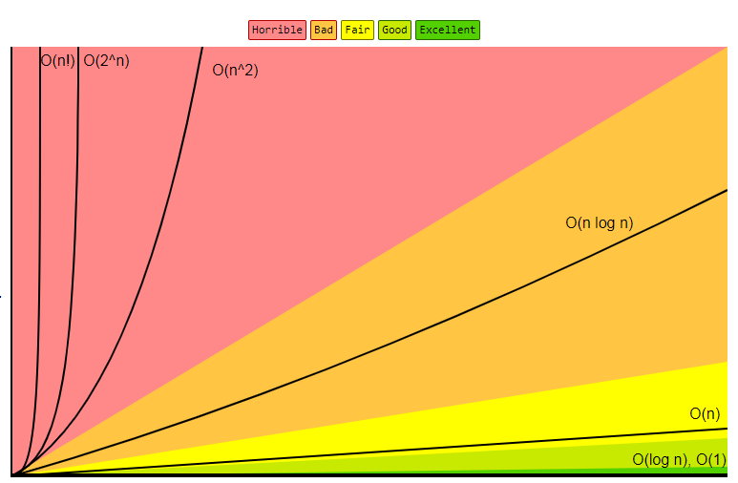
Compare
http://bigocheatsheet.com/

Slide 44
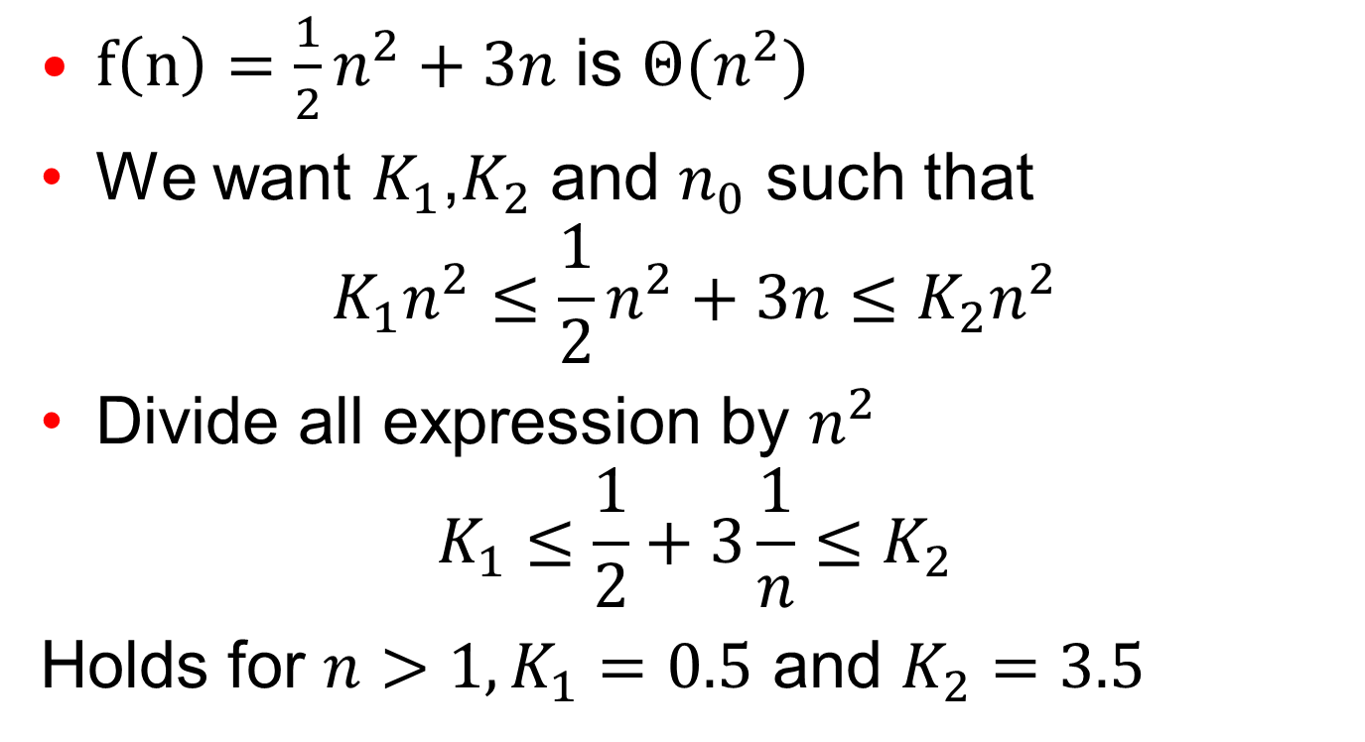
Example
$f\left(n\right)=\frac{1}{2}n^{2}+3n$ is $Θ(n^{2})$
We want $K_{1}$,$K_{2}$ and $n_{0}$ such that
$$K_{1}n^{2}≤\frac{1}{2}n^{2}+3n≤K_{2}n^{2}$$
Divide all expression by $n^{2}$
$$K_{1}≤\frac{1}{2}+3\frac{1}{n}≤K_{2}$$
Holds for $n>1, K_{1}=0.5$ and $K_{2}=3.5$

Slide 45
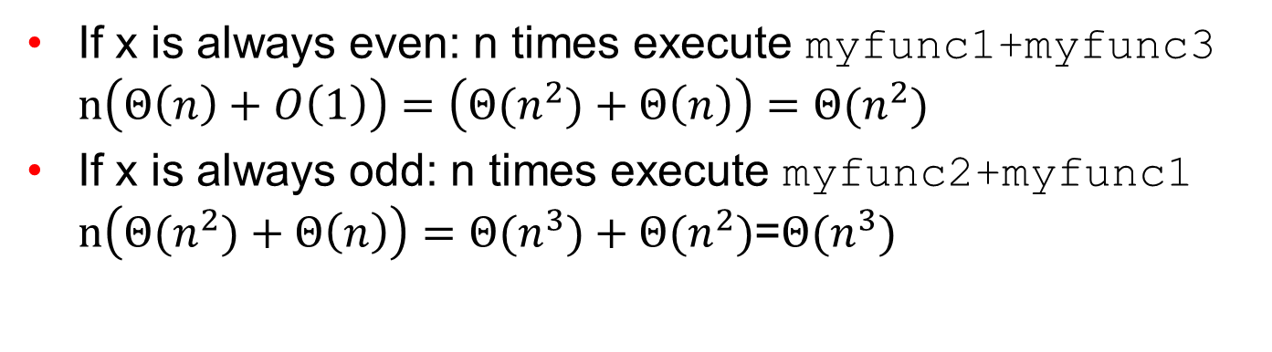
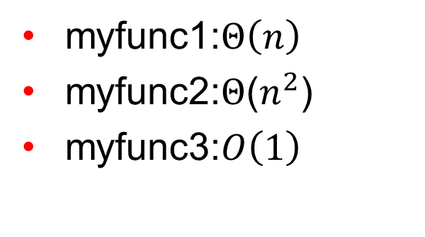
Example
int RandFunc(int n, int seed)
{int x= Rand(seed);
for(int i=0;i<n;i++)
{if(x%2==0)myfunc1+myfunc3;
else myfunc2+myfunc1;}
}
myfunc1:$Θ\left(n\right)$
myfunc2:$Θ$($n^{2}$)
myfunc3:$O\left(1\right)$
If x is always even: n times execute myfunc1+myfunc3 $n\left(Θ\left(n\right)+O\left(1\right)\right)=$ $\left(Θ{(n}^{2})+Θ\left(n\right)\right)=Θ{(n}^{2})$
If x is always odd: n times execute myfunc2+myfunc1 $n\left(Θ{(n}^{2})+Θ\left(n\right)\right)=Θ{(n}^{3})+Θ{(n}^{2})$=$Θ{(n}^{3})$

Slide 46
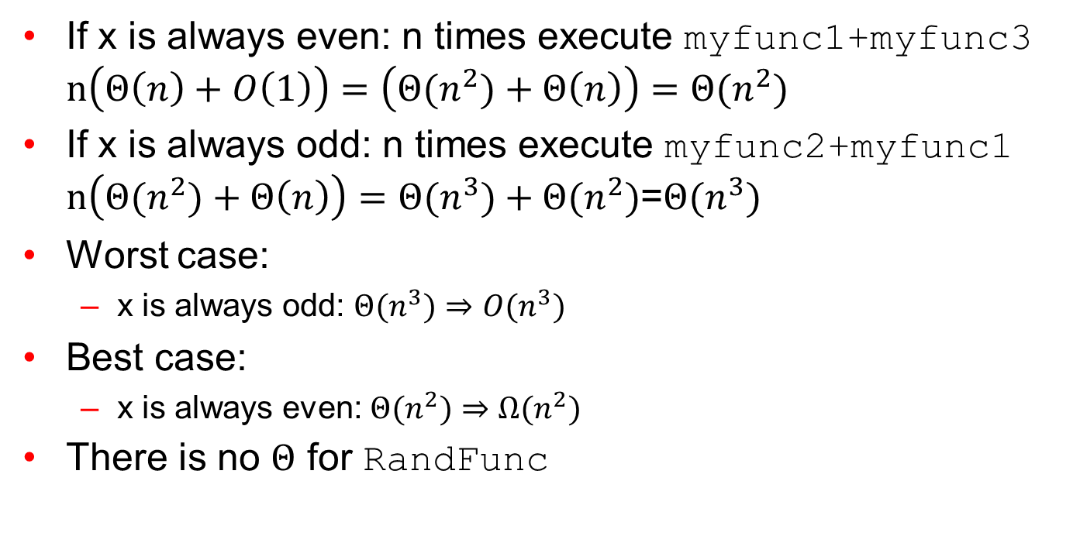
Example
If x is always even: n times execute myfunc1+myfunc3 $n\left(Θ\left(n\right)+O\left(1\right)\right)=$ $\left(Θ{(n}^{2})+Θ\left(n\right)\right)=Θ{(n}^{2})$
If x is always odd: n times execute myfunc2+myfunc1 $n\left(Θ{(n}^{2})+Θ\left(n\right)\right)=Θ{(n}^{3})+Θ{(n}^{2})$=$Θ{(n}^{3})$
Worst case:
x is always odd: $Θ{(n}^{3})⇒O{(n}^{3})$
Best case:
x is always even: $Θ{(n}^{2})⇒Ω{(n}^{2})$
There is no $Θ$ for RandFunc

Slide 47

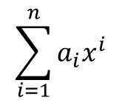
Example
$$\sum_{i=1}^{n}{a_{i}x^{i}}$$
int Power (int a[], int n, int x)
{int xpower=1; t1
result=a[0]*xpower; t2
for(int i=1;i<=n;i++) t3a t3b t3c
{xpower=x*xpower; t4
result+=a[i]*xpower;} t5
return result; t6
}
T(n)=t1 + t2 + t3a + (n+1)t3b + n(t3c+t4+t5) + t6
T(n)=TA+nTB
$$O\left(n\right), Θ\left(n\right), Ω(n)$$

Slide 48
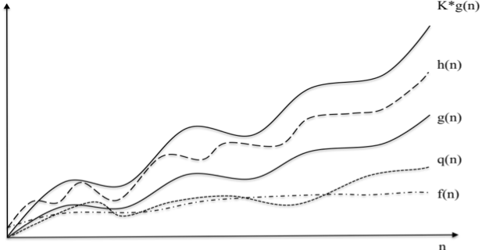
Example
Consider the given figure. Let p(n)= h(n)+ f(n)
Find the TIGHTEST O(.) ,Ω(.) and Θ(.) complexities of
h(n), q(n) and p(n) expressed in terms of f(n) and g(n).
Solution:
h(n): Θ(g(n))
q(n): O(g(n)), Ω(f(n))
p(n): Θ(g(n))

Slide 49
EE 441 Data Structures
Lecture 3:
Algorithm Complexity

